Slide 1

Chapter 4 Key terms

Slide 2

What is the #include directive?

Slide 3

Answer: #include directive
Tells the computer to merge the source code from one file with the source code from another file

Slide 4

% - (not the percent sign!)

Slide 5
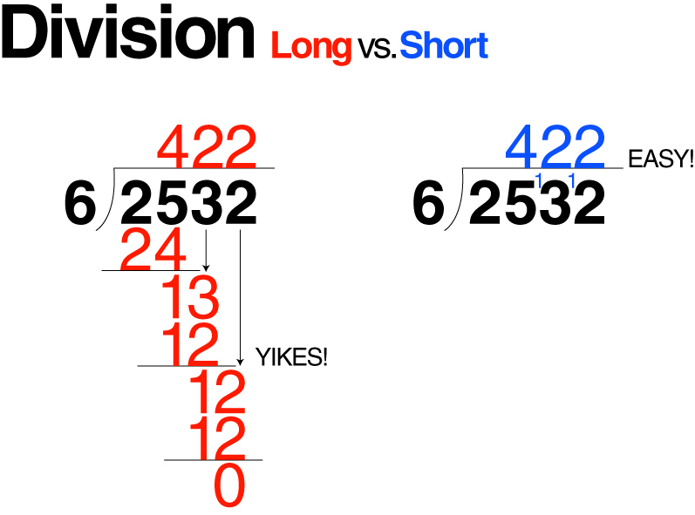
%
Modulus (remainder) operator
Divides two integers and returns the remainder as an integer

Slide 6
What is <<?
<<

Slide 7
Answer: <<
Insertion operator

Slide 8
What is >>?
Extraction operator

Slide 9

What are Arithmetic assignment operators?

Slide 10
Arithmetic assignment operators
Have both the assignment and arithmetic operator together;
Used to shorten an assignment statement
+=
-=
*=
/=

Slide 11

What is An Assignment operator?

Slide 12
Answer: the equal sign

Slide 13
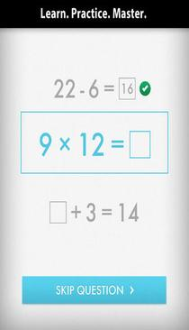
What is an Assignment statement?

Slide 14
Answer: Assignment statement
Assigns a value to a variable during runtime

Slide 15

What are bugs?

Slide 16

Answer: bugs
Errors in the program

Slide 17
What is cin?

Slide 18
Answer: cin
The standard input stream object in C++
Tells the computer to paused while the user enters characters at the keyboard and then temporarily stores those characters

Slide 19

What is a comment?

Slide 20
Answer: comment
//
Used to document a program internally

Slide 21
What is cout?

Slide 22
Answer: cout
Standard output stream object;
Used with the insertion operator to display information on the screen

Slide 23

What is debugging?

Slide 24

Answer: debugging
Process of locating and correcting any errors in a program

Slide 25

What is endl?

Slide 26

Answer: endl
A stream manipulator; advances the cursor to the next line

Slide 27

What is an Executable file?

Slide 28
Answer: Executable file
A file that contains all of the machine code necessary to run a program;
Has a .exe extension

Slide 29
What is Explicit type conversion?

Slide 30
Answer: Explicit type conversion
When the program specifically commands the conversion of data from one type to another;
Uses static_cast
Also called a type cast

Slide 31

What is an Extraction operator?

Slide 32
Answer: Extraction operator
>>
Removes characters from the cin object and sends them in to the computer’s internal memory

Slide 33
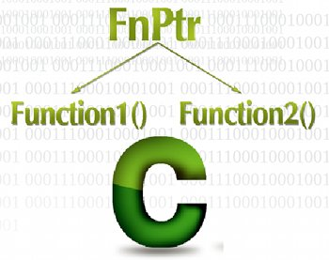
What is a function?

Slide 34

Answer: function
A block of code that performs a task

Slide 35

What is a Function body?

Slide 36
Answer: Function body
Code contained between a function’s opening and closing braces {}

Slide 37

What is a Function header?

Slide 38
Answer: Function header
The first line in a function
Marks the beginning of the function
Main ()

Slide 39

What is an IDE?

Slide 40
Answer: IDE
Integrated development environment
Visual Studio 2019

Slide 41

What is an Insertion operator?

Slide 42
Answer: Insertion operator
<<
Used with cout to display information on the screen

Slide 43
What is an Integrated development environment?

Slide 44
Answer: Integrated development environment
A system that includes both an editor and a compiler

Slide 45

What is a linker?

Slide 46
Answer: linker
A program that combines the code in a C++ program’s object file with other machine code needed to run the program

Slide 47

What is a Logic error?

Slide 48
Answer: Logic error
An error (bug) that occurs during the runtime of a program that causes bad data

Slide 49

What is a Modulus operator?

Slide 50
Answer: Modulus operator
%
Returns the remainder after dividing two integers

Slide 51

What is Object code?

Slide 52

Answer: Object code
Machine code

Slide 53

What is a prompt?

Slide 54
Answer: prompt
A message displayed on the screen indicating the type of data the user should enter

Slide 55
What is Source code?

Slide 56
Answer: Source code
The program instructions that you enter using an editor.
The instructions are saved in a source file.

Slide 57

What is a Source File?

Slide 58
Answer: Source File
The file that contains the program’s source code
.cpp

Slide 59
What is a Static_cast operator?

Slide 60
Answer: Static_cast operator
Used to explicitly convert one data type to another
Type cast

Slide 61

What is a Stream?

Slide 62

Answer: Stream
A sequence of characters

Slide 63
What is a Stream manipulator?

Slide 64
Answer: Stream manipulator
Allows a C++ program to manipulate the characters in either the input or the output stream

Slide 65
What are Stream objects?

Slide 66
Answer: Stream objects
Objects used to perform standard input and output operations in C++
cin
cout

Slide 67
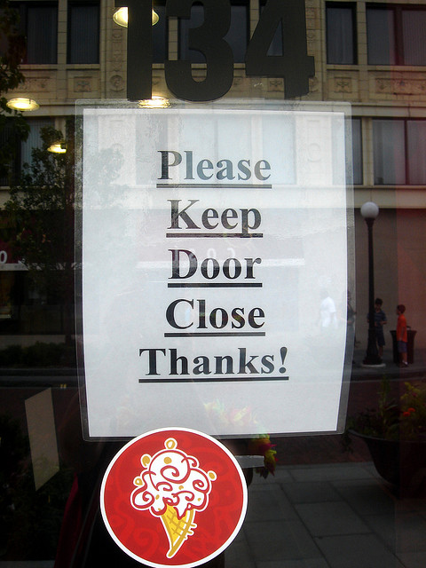
What is a Syntax error?

Slide 68
Answer: Syntax error
An error that occurs when a program instruction violates a programming languages syntax rules

Slide 69

What is Type cast?

Slide 70
Answer: Type cast
Explicit type conversion

Slide 71
What is the Using directive?
Using namespace std;

Slide 72
Answer: Using directive
An instruction that tells the computer where it can find the definitions of keywords and classes

Slide 73

What is a White space character?

Slide 74
Answer: White space character
A newline character
A tab character
A blank space character

